Slide 1
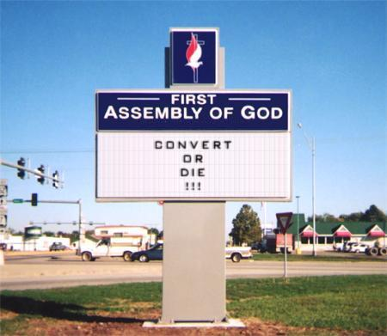
Locke I: Religious Toleration
Politics 2A
Dr Carl Knight, Lecturer in Political Theory

Slide 2
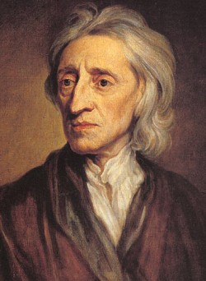
LECTURE OVERVIEW
The life and works of
John Locke
Philosophy
Religious toleration

Slide 3
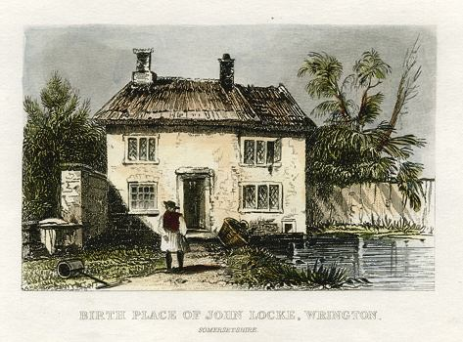
JOHN LOCKE (1632-1704)
Born Wrington, Somerset
Studied and lectured at Oxford, member Royal Soc.
Associated with Robert Boyle, Isaac Newton, etc.
Physician to Anthony Ashley Cooper (Earl of Shaftesbury), leading politician & founder of Whigs
Spent late 1670s in France as tutor and medic
Returned 1679, only to flee to Netherlands under suspicion of plot to kill Charles and James
Returned 1689 under new government

Slide 4
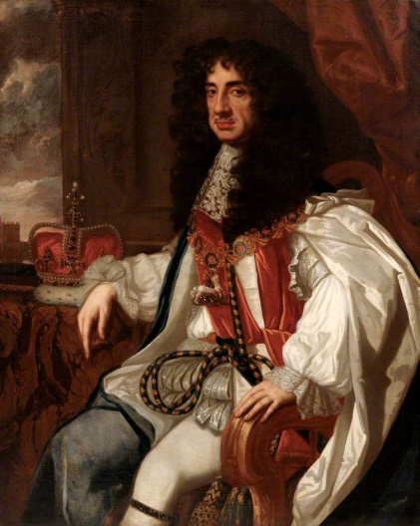
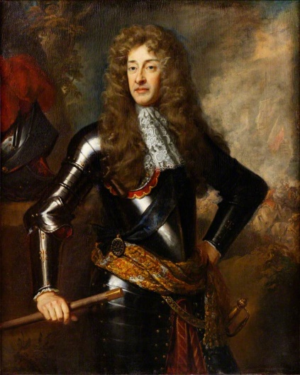
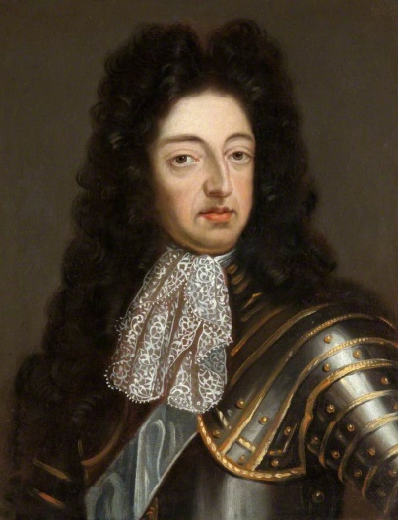
POLITICS
Like Hobbes, Locke lived through tumultuous times, again shaped largely by conflict between monarchy and parliament, as well as religious conflict
Locke, writing decades after Hobbes but grappling with similar questions, was on opposite side
Associated with the Whigs who sought to defend parliament against the incursions of Charles II
Supported the ‘Glorious Revolution’ of 1688 that replaced Charles’ brother James II with William III

Slide 5
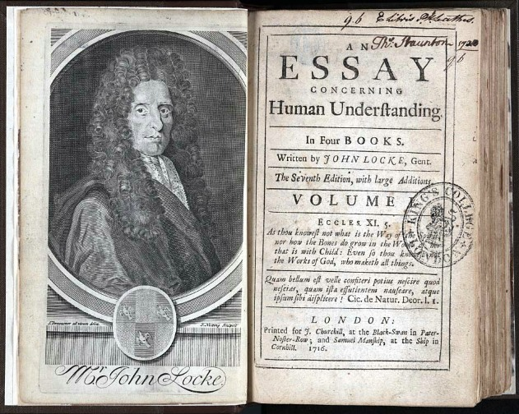
MAJOR WORKS
A Letter Concerning Toleration (1689), Second and Third Letters Concerning Toleration (1690 and 1692)
Two Treatises of Government (1689)
An Essay Concerning Human Understanding (1690)
Some Thoughts Concerning Education (1693)
The Reasonableness of Christianity (1695), (1695) A Vindication of the Reasonableness of Christianity

Slide 6

PHILOSOPHY
Immense influence - comparable to Plato & Aristotle
Essay: How can human mind acquire knowledge?
Tabula rasa (‘white paper’) - knowledge not innate
Knowledge from (1) sense perceptions, (2) reflection
Emphasizes consciousness (e.g. conception of God)
Founder of both empiricism & liberalism (Treatises)
Curiously, no sustained attempt at moral philosophy

Slide 7
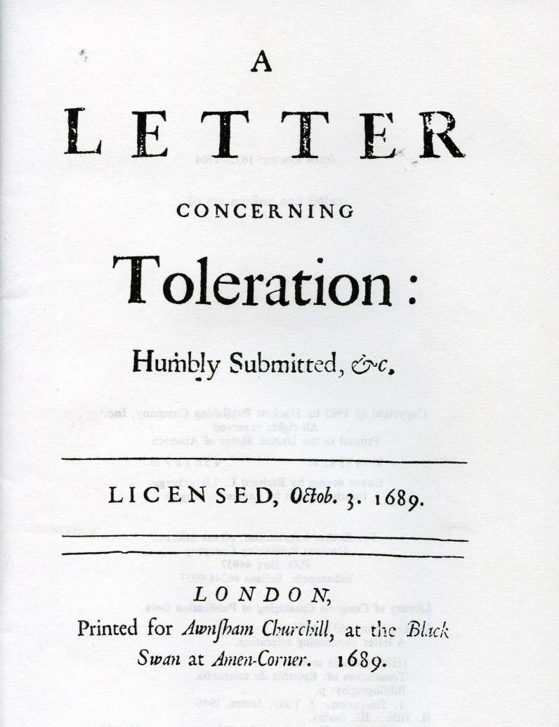
A LETTER CONCERNING TOLERATION
Two main claims:
(1) People should not be coerced by the government in an attempt to make them practice a specific religion
(2) Religious groups should not exercise coercion over either insiders or outsiders
Addresses toleration within Christianity – Church of England, Catholic, and non-conformist Protestants

Slide 8
SOCIAL OBJECTIVES
‘The commonwealth seems to me to be a society of men constituted only for the procuring, preserving, and advancing their own civil interests. Civil interest I call life, liberty, health, and indolency of body; and the possession of outward things, such as money, lands, houses, furniture, and the like. It is the duty of the civil magistrate, by the impartial execution of equal laws, to secure unto all the people in general, and to every one of his subjects in particular, the just possession of these things belonging to this life’.
Classical liberal and anti-perfectionist
‘Absolute liberty, just and true liberty, equal and impartial liberty, is the thing that we stand in need of’.

Slide 9

CHARITY
Charity and humility as foremost Christian duties: ‘For whatsoever some people boast of the antiquity of places and names, or of the pomp of their outward worship; others, of the reformation of their discipline ; all, of the orthodoxy of their faith, for every one is orthodox to himself : these things, and all others of this nature, are much rather marks of men’s striving for power and empire over one another, than of the church of Christ. Let any one have ever so true a claim to all these things, yet if he be destitute of charity, meekness, and goodwill in general towards all mankind, even to those that are not Christians, he is certainly yet short of being a true Christian himself’.
Goodwill towards others requires toleration: ‘I esteem that toleration to be the chief characteristical mark of the true church’.

Slide 10
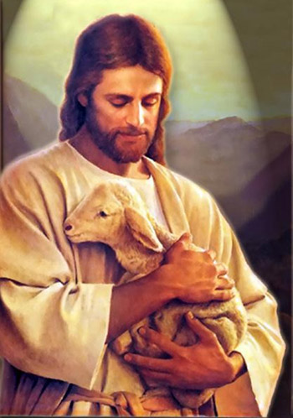
METHODS
If conversion appropriate, forceful methods impermissibly un-Christian:
‘those who do not really contend for the advancement of the true religion, and of the church of Christ, make use of arms that do not belong to the Christian warfare. If, like the Captain of our salvation, they sincerely desired the good of souls, they would tread in the steps and follow the perfect example of that Prince of Peace, who sent out his soldiers to the subduing of nations, and gathering them into his church, not armed with the sword, or other instruments of force, but prepared with the Gospel of peace, and with the exemplary holiness of their conversation’.

Slide 11

HYPOCRISY
Points out inconsistencies in actions of religious persecutors
Punish those of other faiths but overlook sins closer to home: ‘Now I appeal to the consciences of those that persecute, torment, destroy, and kill other men upon pretence of religion, whether they do it out of friendship and kindness towards them, or no: and I shall then indeed, and not till then, believe they do so, when I shall see those fiery zealots correcting, in the same manner, their friends and familiar acquaintance, for the manifest sins they commit against the precepts of the Gospel’
e.g. ‘conscientious dissent from ecclesiastical decision’ vs. ‘whoredom, fraud, malice, and such like enormities’

Slide 12
NO BASIS FOR DUTY TO FORCE
Belief is not responsibility of state or other people
Bible doesn’t command magistrates to force faith
Nor could the people coherently will that magistrates force them to believe
‘it appears not that God has ever given any such authority to one man over another, as to compel any one to his religion. Nor can any power be vested in the magistrate by the consent of the people; because no man can so far abandon the care of his own salvation as blindly to leave it to the choice of any other, whether prince or subject, to prescribe to him what faith or worship he shall embrace’

Slide 13
BELIEF CANNOT BE FORCED
True religious belief involves a deep inner conviction
Force is a means only to outward compliance
Hence, government cannot create true belief
‘The care of souls cannot belong to the civil magistrate, because his power consists only in outward force : but true and saving religion consists in the inward persuasion of the mind, without which nothing can be acceptable to God. And such is the nature of the understanding, that it cannot be compelled to the belief of any thing by outward force. Confiscation of estate, imprisonment, torments, nothing of that nature can have any such efficacy as to make men change the inward judgment that they have framed of things’.

Slide 14

HYPOCRISY, PART II
Hypocrisy of forced convertee:
‘no man can, if he would, conform his faith to the dictates of another. All the life and power of true religion consists in the inward and full persuasion of the mind; and faith is not faith without believing. Whatever profession we make, to whatever outward worship we conform, if we are not fully satisfied in our own mind that the one is true, and the other well-pleasing unto God, such profession and such practice, far from being any furtherance, are indeed great obstacles to our salvation. For in this manner, instead of expiating other sins by the exercise of religion, I say, in offering thus unto God Almighty such a worship as we esteem to be displeasing unto him, we add unto the number of our other sins, those also of hypocrisy, and contempt of his Divine Majesty’.

Slide 15

MAGISTRATES ARE OFTEN WRONG
Even if belief could be forced, this would not do God’s work
Magistrates around the world hold contradictory religious views
Most of these must be wrong
Hence, even if magistrates successfully converted everyone to their favoured religion, there is no reason to suppose that this would increase the number of believers of the true religion

Slide 16

THE INTERNATIONAL LOTTERY
‘In the variety and contradiction of opinions in religion, wherein the princes of the world are as much divided as in their secular interests, the narrow way would be much straitened ; one country alone would be in the right, and all the rest of the world put under an obligation of following their princes in the ways that lead to destruction : and that which heightens the absurdity, and very ill suits the notion of a Deity, men would owe their eternal happiness or misery to the places of their nativity’.

Slide 17

ACTIVITY
Are Locke’s arguments about religious toleration relevant in the 21st century?
You may wish to discuss Locke’s arguments about:
The role of government as securing civil interests
Charitable duties versus methods of conversion
Magistrate has not been placed in charge of souls
Force cannot bring people to truly believe
The fallibility of magistrates

Slide 18
LIMITS OF TOLERATION
Should not tolerate the intolerant, or those with ‘opinions contrary to human society’ – though these rarely openly stated
Nor those with views ‘in effect opposite to the civil right of the community’ – e.g. ‘faith is not to be kept with heretics’.
Nor ‘That Church … which is constituted upon such a bottom that all those who enter into it do thereby ipso facto deliver themselves up to the protection and service of another prince’. Catholic church!

Slide 19

TOLERATION AND CATHOLICISM
Locke seems to suggest that persecution of Catholic church (!) is justified as it poses a threat to state
Some (e.g. Goldie) argue that Locke’s dispute is not with Catholicism per se but rather antinomianism (rejection of moral laws for religious truth)
‘If a Roman Catholic believe that to be really the body of Christ, which another man calls bread, he does no injury thereby to his neighbour’ (transubstantiation).
Struggles to reconcile his toleration of Catholic religious belief with universal jurisdiction of Church

Slide 20
DISORDER
Locke’s argument is framed in terms of effective governance, including public order
Catholics are already unified - unification not a risk
However, persecution of Protestant non-conformists (‘fanatics’) would increase risk to state, as it may unify a numerous but fragmented grouping: ‘if you persecute them you make them all of one party’
Hence, contra Hobbes, argues that a diversity of religious beliefs is actually more stable.

Slide 21
CONCLUSIONS
‘These considerations, to omit many others that might have been urged to the same purpose, seem unto me sufficient to conclude, that all the power of civil government relates only to men’s civil interests, is confined to the care of the things of this world, and hath nothing to do with the world to come’.
Also concludes, on related grounds (e.g. that belief can’t be forced), that there is no basis for churches to exercise force over anyone, within or without
‘Nobody therefore, in fine, neither single persons, nor churches, nay, nor even commonwealths, have any just title to invade the civil rights and worldly goods of each other, upon pretence of religion’.

Slide 22

Next Lecture: The State of Nature and Property

